Slide 1


Electric Circuits
Twelfth Edition, Global Edition
Chapter 7 – Part 4
Response of First-Order R L and R C Circuits
© 2024 Pearson Education Ltd. All Rights Reserved.
Notes:
If this PowerPoint presentation contains mathematical equations, you may need to check that your computer has the following installed:
1) Math Type Plugin
2) Math Player (free versions available)
3) NVDA Reader (free versions available)

Slide 2
Chapter 7 – Sequential Switching Problems (1 of 22)
Sometimes first-order R L/R C circuits have multiple switching times. This can happen when a circuit has
One switch that goes back and forth between two positions at different times
One switch that has three or more positions and at least two different switching times
Two or more switches whose positions change at different times.

Slide 3
Chapter 7 – Sequential Switching Problems (2 of 22)
Such circuits can exhibit the natural response, the step response, or both!
We analyze the behavior of a sequential switching circuit using the same analysis method used for first-order circuits with only one switching time, repeating the process for each time segment!
The next slide reviews the analysis method. Examples will be used to illustrate.

Slide 4










Chapter 7 – R L/R C Natural and Step Response (1 of 2)
This is a general solution method for both the natural and step responses of first-order circuits. A circuit exhibiting a natural response has no independent source
as
so its final value
Step 1 – Identify the variable x(t), which is the inductor current for R L circuits and capacitor voltage for R C circuits
Step 2 – Calculate the initial value
by analyzing the circuit to find x(t) for
Step 3 – Calculate the time constant
for R L circuits,
and for R C
circuits,
where R is the equivalent resistance connected to the
inductor or capacitor for
Step 4 – Calculate the final value
by analyzing the circuit to find x(t) as

Slide 5

Chapter 7 – R L/R C Natural and Step Response (2 of 2)
Step 5 – Write the equation for x(t),
for
Step 6 – Calculate other quantities of interest using x(t).

Slide 6

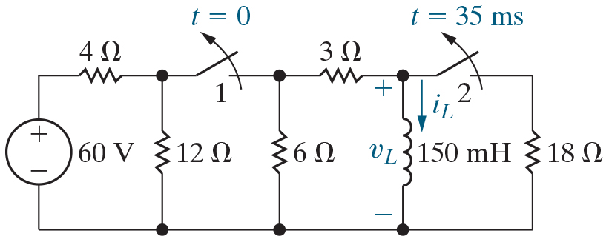
Chapter 7 – Sequential Switching Problems (3 of 22)
Both switches have been closed for a long time. At t = 0, switch 1 is opened and stays open. Switch 2 opens 35 m s later and stays open. Find the expression for the voltage
drop across the inductor for

Slide 7

Chapter 7 – Sequential Switching Problems (4 of 22)
How many different time segments are defined for this circuit
for
A. 1
B. 2
C. 3

Slide 8


Chapter 7 – Sequential Switching Problems (4 of 22)
How many different time segments are defined for this circuit
for
A. 1
B. 2
C. 3

Slide 9





Chapter 7 – Sequential Switching Problems (5 of 22)
Both switches have been closed for a long time. At t = 0, switch 1 is opened and stays open. Switch 2 opens 35 m s later and stays open. Find the expression for the voltage drop
across the inductor for
Analysis for the first time segment,
  Step 1 – Identify the variable x(t), which is the inductor current
  Step 2 – Calculate the initial value
  by analyzing the circuit to
  find
  for

Slide 10

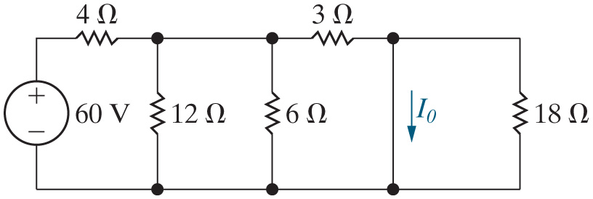



Chapter 7 – Sequential Switching Problems (6 of 22)
Here is the circuit for
The current
is the current in
which resistor?
A.
B.
C.

Slide 11
Chapter 7 – Sequential Switching Problems (6 of 22)
Here is the circuit for
The current
is the current in
which resistor?
A.
B.
C.

Slide 12

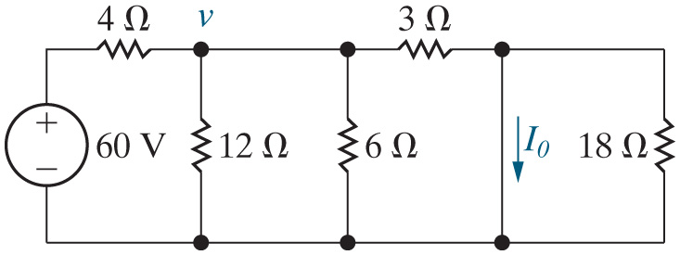
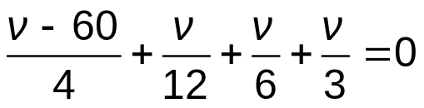


Chapter 7 – Sequential Switching Problems (7 of 22)
Both switches have been closed for a long time. At t = 0, switch 1 is opened and stays open. Switch 2 opens 35 m s later and stays open. Find the expression for the voltage
drop across the inductor for
Analysis for the first time segment,
  Step 2 – Calculate the initial value
by analyzing the circuit to find
for
Write a K V L equation.

Slide 13

Chapter 7 – Sequential Switching Problems (8 of 22)
Next we need to find the final value of the inductor current,
To do this, analyze the circuit with the switches in
the following positions:
A. SW 1 closed, SW 2 closed
B. SW 1 open, SW 2 closed
C. SW 1 open, SW 2 open

Slide 14
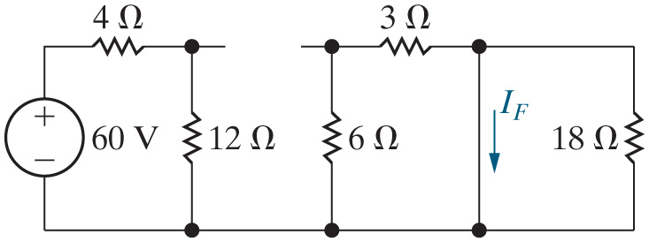
Chapter 7 – Sequential Switching Problems (9 of 22)
Here is the circuit used to determine the final value of the current in the first time segment. For this time segment, is the response form the natural response or the step response?
A. Natural response
B. Step response

Slide 15
Chapter 7 – Sequential Switching Problems (9 of 22)
Here is the circuit used to determine the final value of the current in the first time segment. For this time segment, is the response form the natural response or the step response?
A. Natural response
B. Step response

Slide 16
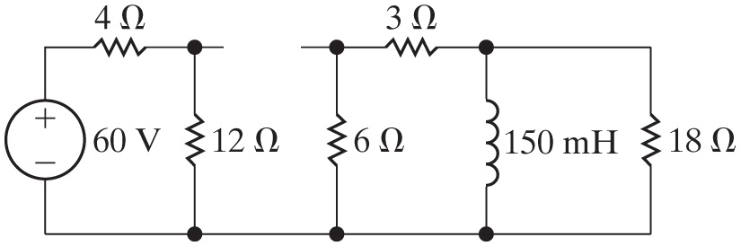



Chapter 7 – Sequential Switching Problems (10 of 22)
Next, calculate the time constant for this time segment. To do this, find the equivalent resistance seen by the inductor for the circuit that exists in this time segment.
A.
B.
C.

Slide 17
Chapter 7 – Sequential Switching Problems (10 of 22)
Next, calculate the time constant for this time segment. To do this, find the equivalent resistance seen by the inductor for the circuit that exists in this time segment.
A.
B.
C.

Slide 18





Chapter 7 – Sequential Switching Problems (11 of 22)
Both switches have been closed for a long time. At t = 0, switch 1 is opened and stays open. Switch 2 opens 35 m s later and stays open. Find the expression for the voltage
drop across the inductor for
Analysis for the first time segment,
  Step 3 – Calculate the time constant

Slide 19




Chapter 7 – Sequential Switching Problems (12 of 22)
Both switches have been closed for a long time. At t = 0, switch 1 is opened and stays open. Switch 2 opens 35 m s later and stays open. Find the expression for the voltage
drop across the inductor for
Analysis for the first time segment,
  Step 4 – Calculate the final value
Natural response!

Slide 20




Chapter 7 – Sequential Switching Problems (13 of 22)
Both switches have been closed for a long time. At t = 0, switch 1 is opened and stays open. Switch 2 opens 35 m s later and stays open. Find the expression for the voltage
drop across the inductor for
Analysis for the first time segment,
  Step 5 – Write the equation for

Slide 21




Chapter 7 – Sequential Switching Problems (14 of 22)
Both switches have been closed for a long time. At t = 0, switch 1 is opened and stays open. Switch 2 opens 35 m s later and stays open. Find the expression for the voltage
drop across the inductor for
Analysis for the second time segment,
  Step 2 – Calculate the initial value
Since the inductor current
must be continuous for all time, this is the value of the inductor current at the end of the last time segment.

Slide 22
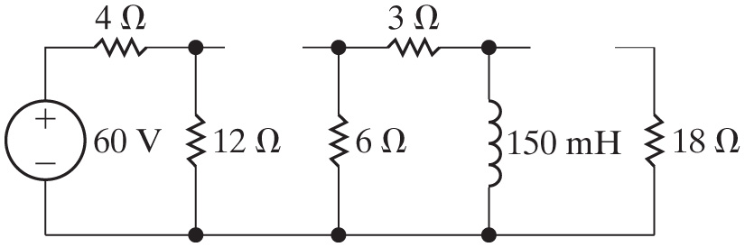

Chapter 7 – Sequential Switching Problems (15 of 22)
Next, calculate the time constant for this time segment. To do this, find the equivalent resistance seen by the inductor for the circuit that exists in this time segment.
A.
B.
C.

Slide 23
Chapter 7 – Sequential Switching Problems (15 of 22)
Next, calculate the time constant for this time segment. To do this, find the equivalent resistance seen by the inductor for the circuit that exists in this time segment.
A.
B.
C.

Slide 24



Chapter 7 – Sequential Switching Problems (16 of 22)
Both switches have been closed for a long time. At t = 0, switch 1 is opened and stays open. Switch 2 opens 35 m s later and stays open. Find the expression for the voltage
drop across the inductor for
Analysis for the second time segment,
  Step 3 – Calculate the time constant

Slide 25

Chapter 7 – Sequential Switching Problems (17 of 22)
Next we need to find the final value of the inductor current,
for the second time segment. To do this, analyze
the circuit with the switches in the following positions:
A. SW 1 closed, SW 2 closed
B. SW 1 open, SW 2 closed
C. SW 1 open, SW 2 open

Slide 26
Chapter 7 – Sequential Switching Problems (17 of 22)
Next we need to find the final value of the inductor current,
for the second time segment. To do this, analyze
the circuit with the switches in the following positions:
A. SW 1 closed, SW 2 closed
B. SW 1 open, SW 2 closed
C. SW 1 open, SW 2 open

Slide 27
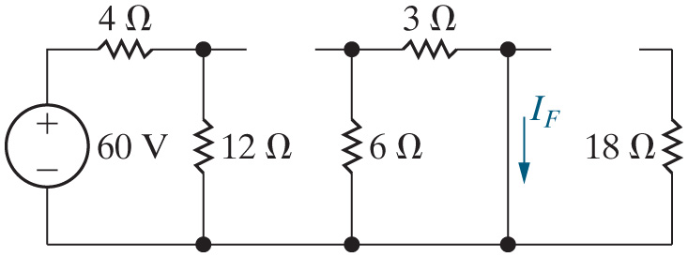
Chapter 7 – Sequential Switching Problems (18 of 22)
Here is the circuit used to determine the final value of the current in the second time segment. For this time segment, is the response form the natural response or the step response?
A. Natural response
B. Step response

Slide 28
Chapter 7 – Sequential Switching Problems (18 of 22)
Here is the circuit used to determine the final value of the current in the second time segment. For this time segment, is the response form the natural response or the step response?
A. Natural response
B. Step response

Slide 29


Chapter 7 – Sequential Switching Problems (19 of 22)
Both switches have been closed for a long time. At t = 0, switch 1 is opened and stays open. Switch 2 opens 35 m s later and stays open. Find the expression for the voltage
drop across the inductor for
Analysis for the second time segment,
  Step 4 – Calculate the final value
Natural response!

Slide 30



Chapter 7 – Sequential Switching Problems (20 of 22)
Both switches have been closed for a long time. At t = 0, switch 1 is opened and stays open. Switch 2 opens 35 m s later and stays open. Find the expression for the voltage
drop across the inductor for
Analysis for the second time segment,
  Step 5 – Write the equation for
Notes:
Long Description:
i subscript L baseline (t) equals I subscript f baseline plus Open Parenthesis I subscript 0 baseline minus I subscript f baseline Close Parenthesis e to the negative open square bracket Open Parenthesis t minus t subscript 0 Close Parenthesis divided by tau close square bracket power.

Slide 31


Chapter 7 – Sequential Switching Problems (21 of 22)
Both switches have been closed for a long time. At t = 0, switch 1 is opened and stays open. Switch 2 opens 35 m s later and stays open. Find the expression for the voltage
drop across the inductor for
Summary:

Slide 32
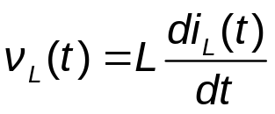

Chapter 7 – Sequential Switching Problems (22 of 22)
Both switches have been closed for a long time. At t = 0, switch 1 is opened and stays open. Switch 2 opens 35 m s later and stays open. Find the expression for the voltage
drop across the inductor for
  Step 6 – Calculate other quantities of interest using

Slide 33

Copyright
This work is protected by United Kingdom copyright laws and is provided solely for the use of instructors in teaching their courses and assessing student learning. Dissemination or sale of any part of this work (including on the World Wide Web) will destroy the integrity of the work and is not permitted. The work and materials from it should never be made available to students except by instructors using the accompanying text in their classes. All recipients of this work are expected to abide by these restrictions and to honor the intended pedagogical purposes and the needs of other instructors who rely on these materials.

